Slide 1
Legislative/Policy Update
Item No. 4
NW Portland Area Indian Health Board
Quarterly Board Meeting
October 17, 2012

Slide 2
Overview
FY 2013 IHS Budget & Sequestration
Oregon and Washington Uncompensated Care Model
Health Reform Update – FFE
TTAG/MMPC Update
Questions

Slide 3
IHS FY 2013 Appropriation (4E)
February President’s request included $115 million increase for IHS
May 28th the House Interior Subcommittee approved FY 2013 Interior-Related Agency bill includes $186 million increase for IHS
  The Full House has yet to action
September 25th the Senate Interior Committee Released FY 2013 Interior-Related Agency bill includes $85 million
Looming issue of Sequestration

Slide 4
IHS FY 2013 President’s Request
Current Services: $85.6 million
  Federal Pay Costs $2.4 million
  Medical Inflation $33.9 million
  Staffing new facilities $49.3 million
Program Increases (Reprogramming)
  CHS increase $20 million
  HIT ICD-10 $6 million
  Direct Operations $1.1 million
  Contract Support Costs $5 million
  Maintenance & Improvement $1.5 million
  Health Facilities Construction $3.6 million

Slide 5
How the Budgets Compare? (4E)
Clinic Services Sub-Accounts
Sub-sub Acct | Request | House | Senate
Hospital & Clinics | $ 1,849,310 | $ 1,851,448 | $ 1,852,948
Dental Services | $ 166,297 | $ 166,597 | $ 166,297
Mental Health | $ 78,131 | $ 78,131 | $ 78,131
Alcohol & Sub Abuse | $ 95,378 | $ 195,378 | $ 195,378
Contract Health Services | $ 897,562 | $ 897,562 | $ 863,575
 | $ 3,186,678 | $ 3,189,116 | $ 3,156,329
House & President’s Request near identical
House includes $2.1 mil. more for H&C; $300K more for Dental
Senate is less $3.6 mil. for H&C
Senate is $34 million less for CHS

Slide 6
How the Budgets Compare? (4E)
Preventive Health Sub-Accounts
Sub-sub Acct | Request | House | Senate
Public Health Nursing | $ 69,868 | $ 69,868 | $ 69,868
Health Education | $ 17,450 | $ 17,450 | $ 17,450
Comm. Health Reps | $ 61,531 | $ 61,531 | $ 61,531
Immunization AK | $ 1,927 | $ 1,927 | $ 1,927
 | $ 150,776 | $ 150,776 | $ 150,776

Slide 7
How the Budgets Compare? (4E)
Other Services
Sub-sub Acct | Request | House | Senate
Urban Health | $ 42,988 | $ 45,488 | $42,988
Indian Health Professions | $ 40,598 | $41,598 | $40,598
Tribal Management | $ 2,577 | $2,577 | $ 2,577
Direct Operations | $ 72,867 | $67,567 | $ 72,867
Self-Governance | $ 6,044 | $6,044 | $6,044
Contract Support Cost | $ 476,446 | $546,446 | $476,446
 | $ 641,520 | $709,720 | $641,520
House provides increase for UIHPs & Professions
House reduces Direct-Ops by $4 million
House provides significant increase of $70 million for CSC
Senate provides slight increase for Direct-Ops
Senate reduces Request by $5 mil. for CSC

Slide 8
IHS Budget & Sequestration – 4E
Budget Control Act of 2011 reduces deficit by $2.3 trillion over 10 years thru two vehicles
  Caps in discretionary spending $841 billion over 10 years
  Super Committee Deficit Reduction Plan
  If Plan not adopted allows process Sequestration
Sequestration
  Not new, Gramm Rudman, mandates automatic across-the-board spending cuts
  Initial analysis indicated that IHS programs would be protected by provision in Gramm Rudman Act
  This would have held IHS harmless up to a 2% reduction
  OMB Report indicates that “IHS funds are subject to full sequestration”

Slide 10
Contract Support Cost Update – 4M
October 1st, NPAIHB and others files FOIA law suit against IHS for not disclosing CSC data/expenditure of public funds
NPAIHB is lead plaintiff that includes coalition of over 250 Tribes and tribal organizations
IHS Director issues September 24th DTLL on Contract Support Cost issues
  Salazar v. Ramah Navajo Chapter USSC case
  Contract Support Cost reporting
  Appropriations
  CSC Policy and the need to revise

Slide 11
OR & WA Uncompensated Care Model – 4A-4B-4C
Project follows successful Arizona 1115 Waiver allows Indians to be exempt from benefits & eligibility restrictions. OR & WA Tribes working on model but have following issues to resolve:
  Waiver FFS versus uncompensated care model
  Will it apply to ACA Medicaid expansion group
  Due to 100% FMAP will be limited to IHS and Tribal Programs; will need UIHP to support
  Benefit Design and base year; MH & LTC services
  Non-eligibles, and 100% FMAP
  Tribal non-federal share options
  Reimbursement mechanism
  Program capacity and surge concerns by CMS

Slide 12
CMS Tribal Technical Advisory Group (TTAG); and
NIHB Medicare, Medicaid Policy Committee (MMPC)
MMPC Report – 4J

Slide 13
Federal Facilitated Exchange
– 4G & 4H
May 16th HHS issued General Guidance on Federally-facilitated Exchange
  How States can partner with HHS to implement selected functions in an FFE,
  Key policies organized by Exchange function, and
  How HHS will consult with a variety of stakeholders to implement an FFE.
NPAIHB Comments developed & submitted via the TTAG
Refer to draft talking points on issues

Slide 14
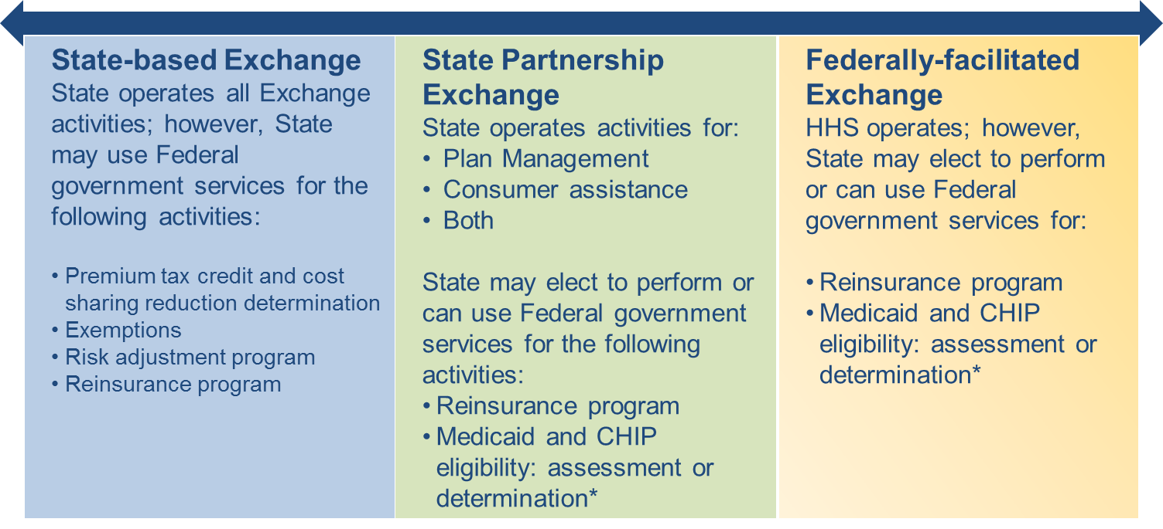
Insurance Exchange Models

Slide 15
Key Points for FFE
State Partnership model will require Tribes to work with states
  Limited administration by states
  Selection of QHP and contracting requirements & licensing
  Network adequacy, ECP, geography, EHBs
  Navigator program & other consumer assistance
HHS will be responsible for
  Eligibility Determination (partner w/States)
  Management of website
  Consumer hotlines

Slide 16
IHS/VA Draft Sharing Agreement – 4I
Aug. 24th DTLL responding to Tribal Consultation concerns
Response to Tribal concerns is generally favorable on such issues:
  Demonstration Sites
  National agreement application to all Tribes
  PRx, LTC and Behavioral health services
  Coordination of eligibility
  Copayments
Agreement will not cover CHS services
Key issue for reimbursement of outpatient services
  April 5th draft provided for encounter rate
  New draft policy is Medicare Rates

Slide 17
Questions/Discussion
Jim Roberts, Policy Analyst
Northwest Portland Area Indian Health Board
jroberts@npaihb.org

